Slide 1
MUSIC RECONSTRUCTION: TRANSLATING THOUGHTS INTO MUSIC

Slide 2
1.
MOTIVATION AND BACKGROUND

Slide 3
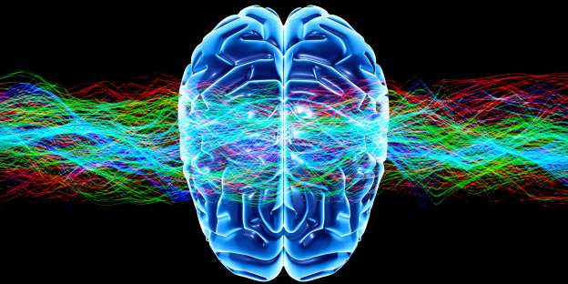
PRIOR WORK
Algorithm to predict finger movements from electrical brain signals
Simple feature extraction w/ linear regression
Accuracy of ~48%
https://www.npr.org/2011/05/12/135598390/mind-reading-technology-turns-thought-into-action?jwsource=cl
Notes:
Eyewitness accounts
These two results point to the conclusion that music reconstruction can indeed be done via the analysis of EEG data.

Slide 4
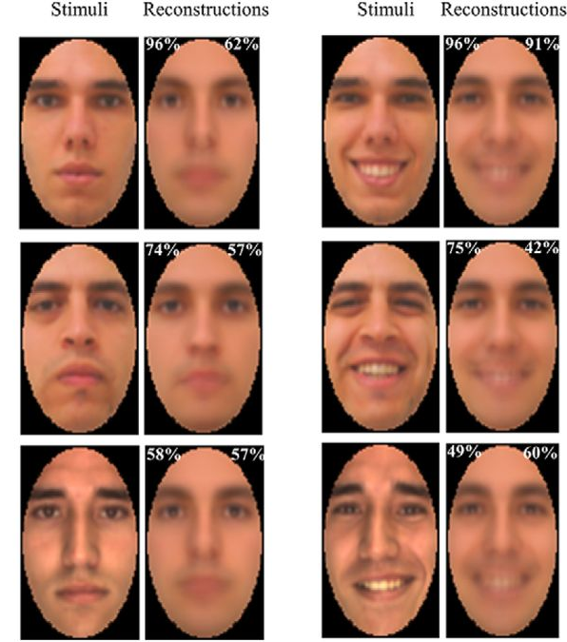
BRAIN ACTIVITY AND PREDICTIONS
Correlation between audio signals and electrical brain activity has been established from prior research
Successful image reconstruction
Potential Neurotech Applications:
Communication
Forensics
Notes:
Eyewitness accounts
These two results point to the conclusion that music reconstruction can indeed be done via the analysis of EEG data.

Slide 5
2.
DATA ACQUISITION & PREPROCESSING

Slide 6
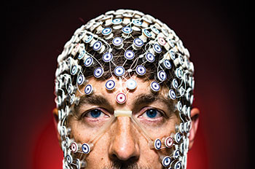
ELECTROENCEPHALOGRAPHY (EEG)
Measure of electrical activity of the brain
Numerous neurons firing synchronously will produce an electrical field strong enough to be measured at the scalp
ECoG - Electrodes placed directly onto cortical surface

Slide 7
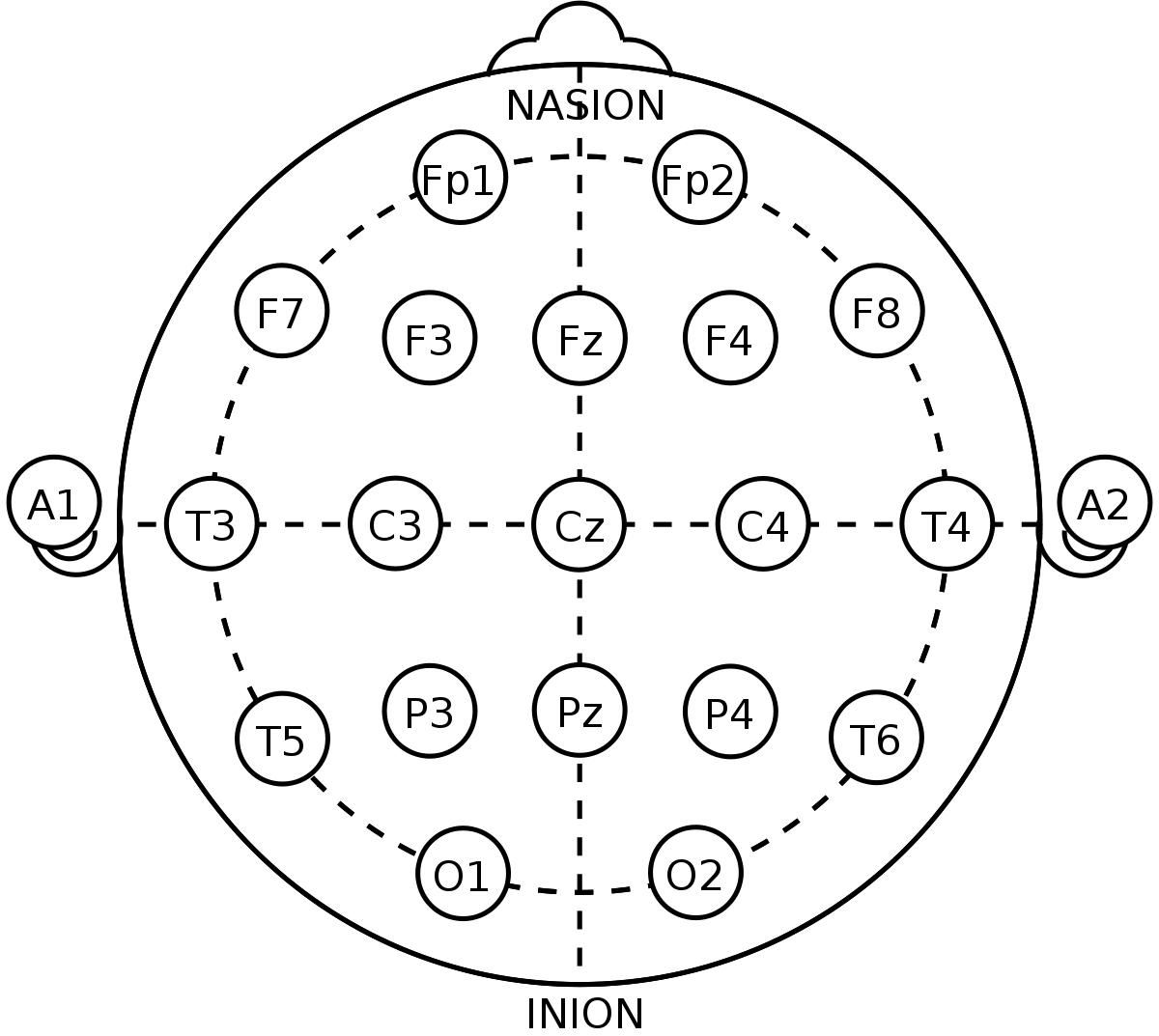
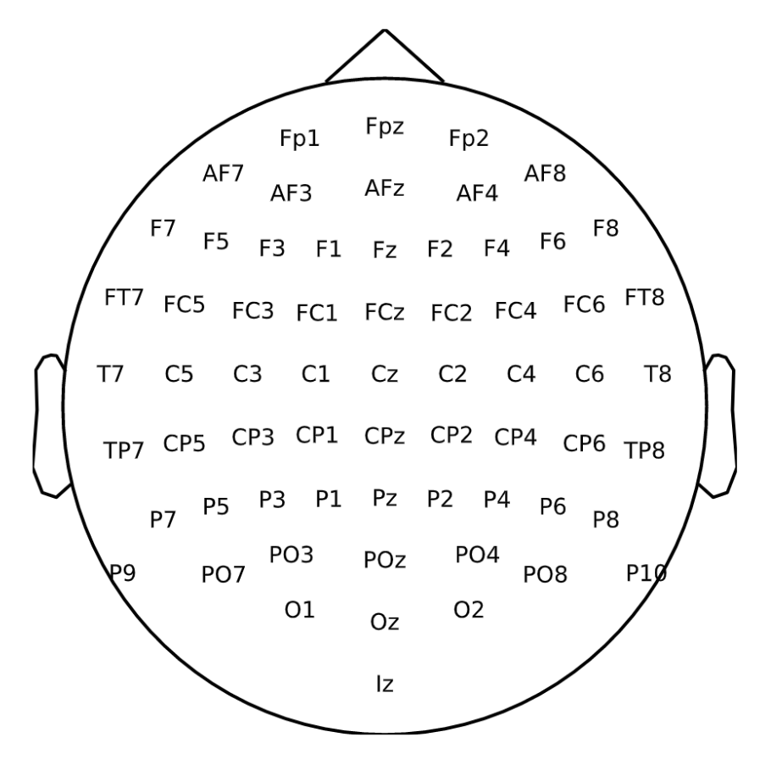
Notes:
Mention sampling on this slide
Analog to digital conversion acquires samples at a specific sampling frequency
Too low - aliasing and reduces the integrity of the signal
Too high- unnecessarily large data files - can just down sample to reduce dimensionality
Always better to over sample than to undersample

Slide 8

OpenMIIR DATASET
“Music imagery information retrieval (MIIR) systems may one day be able to recognize a song just as we think of it. As a step towards such technology, we are presenting a public domain dataset of electroencephalography (EEG) recordings taken during music perception and imagination.”
Special thanks to Sebastian Stober
Professor for Artificial Intelligence at Otto-von-Guericke-University Magdeburg
Head of Machine Learning in Cognitive Science research group at the University of Potsdam

Slide 9
CLEANING UP THE DATA
EEG is often noisy and subject to a variety of undesirable artifacts.
Physiologic
Muscles (eyes, jaws, etc.)
Sweat (Impedance)
Extra-Physiologic
60Hz AC Noise
Bridged electrodes
Defective electrodes

Slide 10
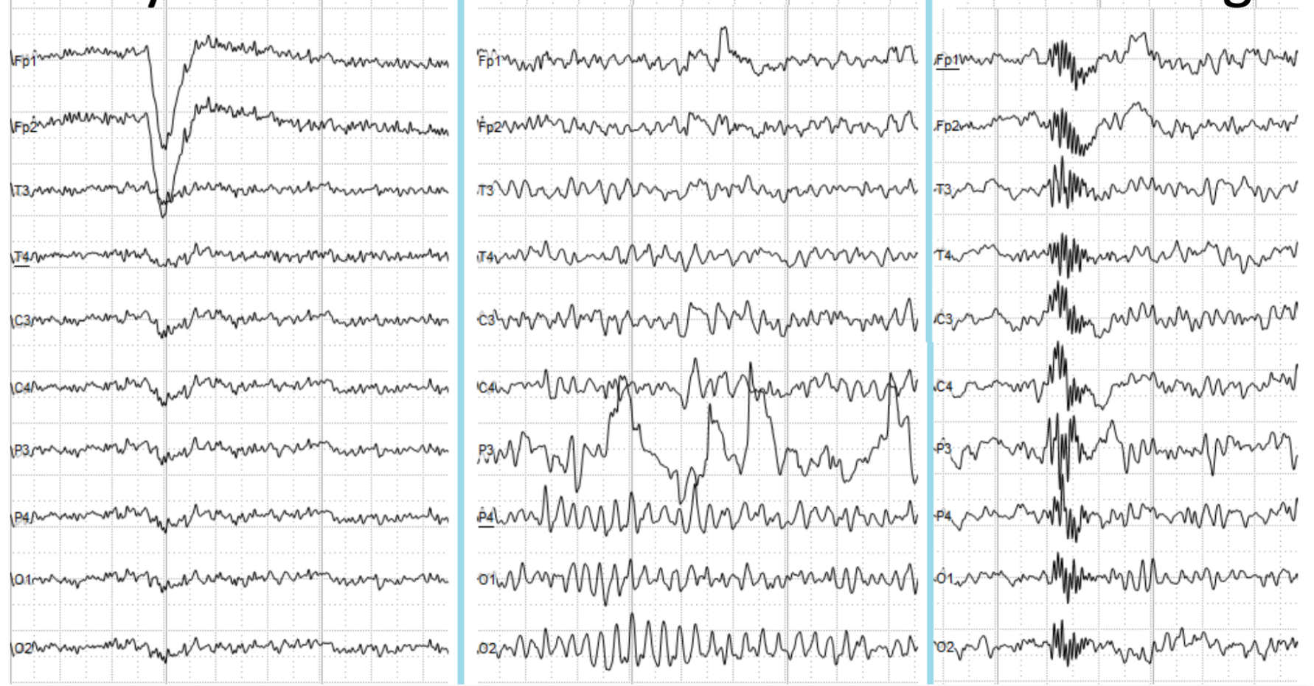
EXAMPLE ARTIFACTS
EYE BLINK
DEFECTIVE ELECTRODE
SWALLOWING

Slide 11
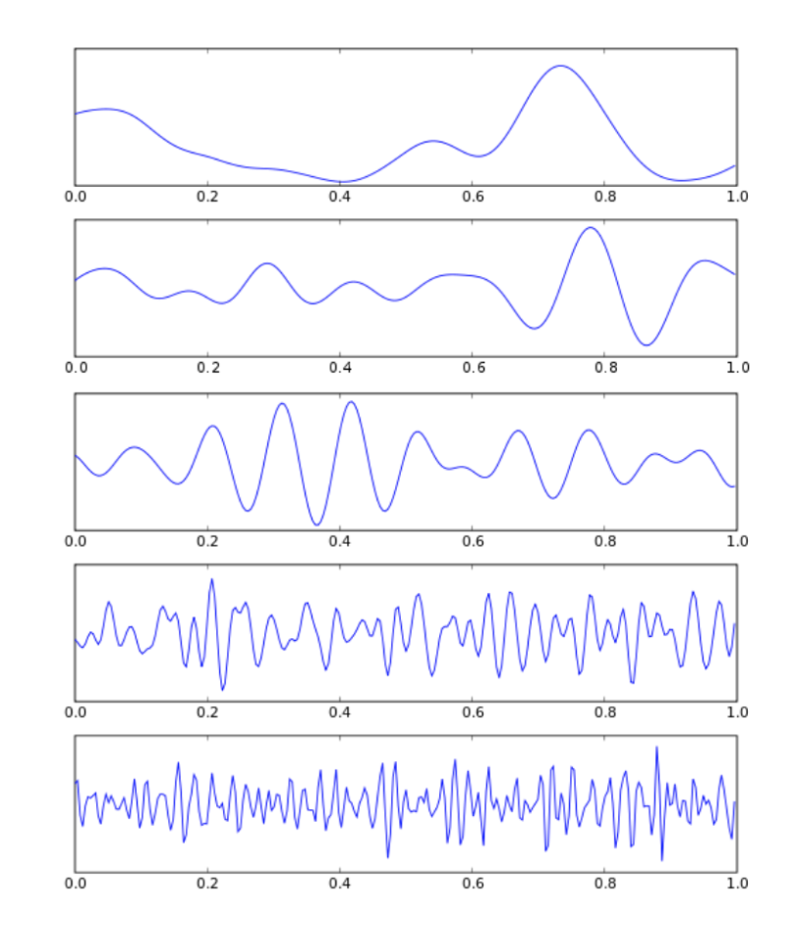
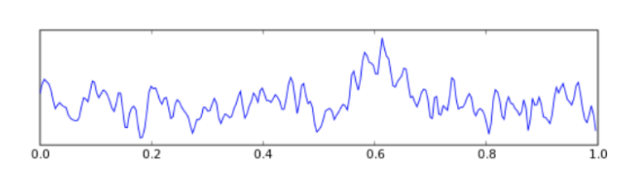
NEURAL OSCILLATIONS
DELTA < 4Hz
THETA 4-8Hz
ALPHA 8-15Hz
BETA 15-30Hz
GAMMA 30-100Hz
Notes:
How can you detect these artifacts
As you saw in the previous slide, the majority of these artifcats are high frequency oscillations cause by muscle movements or just 60Hz noise.

Slide 12
NEURAL OSCILLATIONS
DELTA < 4Hz
THETA 4-8Hz
ALPHA 8-15Hz
BETA 15-30Hz
GAMMA 30-100Hz

Slide 13
DEALING WITH EEG ARTIFACTS
EXCLUSION
Exclude data of a channel that is defective. Optimal solution when dealing with many electrodes/trials.
REMOVAL
Remove the noise via filtering. Perfect solution for targeting 60Hz AC noise or any high-frequency muscle artifacts.
Notes:
If its the case where its not really interference but its more a faulty electrode/channel then it would probs be best to get rid of its entirety
When only a specific portion of the time series is corrupted then filtering is the best solution

Slide 14

PREPROCESSING PIPELINE
RAW DATA ACQUISITION
REJECT BAD CHANNELS
BANDPASS FILTER
0.5-30Hz
DOWNSAMPLING

Slide 15
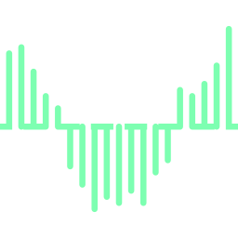

DATA STRUCTURE
12 Patients
12 Songs
540 Trials
6.87 Seconds EEG
512 Hz
3,518 Samples/Trial
3,518 SAMPLES

Slide 16
3.
TRAINING

Slide 17
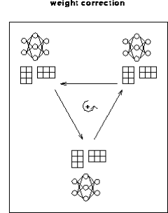
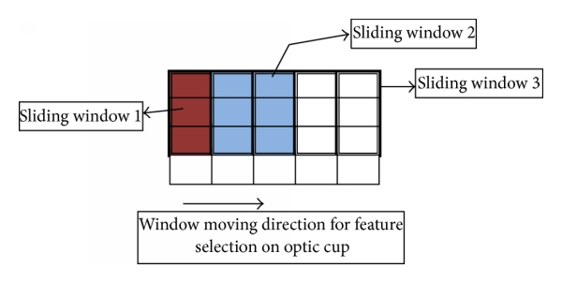

SETUP
1. Moving Window Feature and Data Selection
2. R and Audio Matrix Constructions, and Feature Aggregation
3. Sequential Batch Learning - NN
Windows x Window Length x Channels

Slide 18
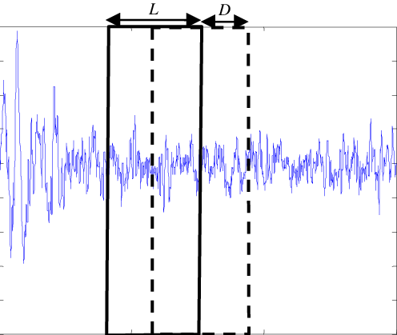
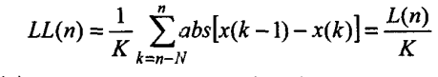
MOVING WINDOW FEATURE SELECTION
Time Series Data
Power per Frequency Band
Area
Energy
Zero Crossings
Line Length
Notes:
Energy = sum(x.^2)

Slide 19
Audio and Feature Matrix Constructions
W1 W2 W3 W13
…….
Ch1 Ch2 Ch3 .
.
.
.
Ch64
Concatenate features into “R” Matrix:
384 samples + 6 features → 1 Window
Rows → channels
One to one matching inputs and output
→ Downsampling of audio matrix to match points per window
3. Select Best Channels Per Window:
→ Dimensionality reduction PCA:
64 channels → 3 components
…………..
44100 Hz
512 Hz
Wx
Ch1 Ch2 Ch3 .
.
.
.
Ch64
Wx
PC1 PC2 PC3
>50% Variance Explained

Slide 20
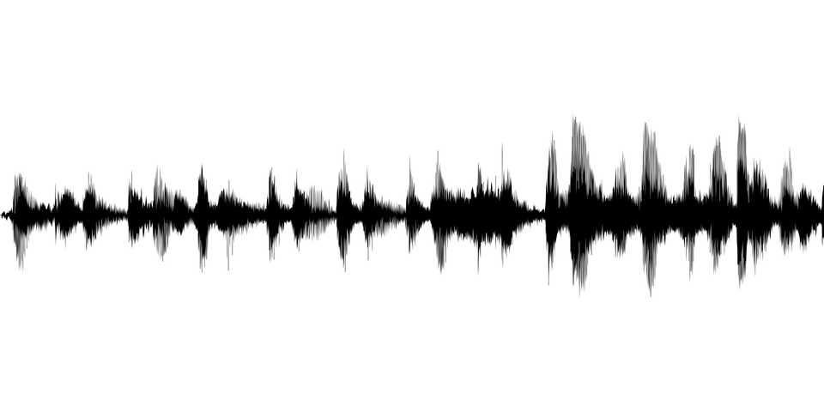
Batch Sequential Learning
Window 1
Window N
PC1 PC2 PC3
Train 1000 iterations Train 800 iterations Train 600 iterations
PC1 PC2 PC3
Train on channel combinations that contain most information (fidelity)
Window Overlap → Memory
Window 1
Window n-1
Window 3
Window 2
Window n
Window 4

Slide 21


Neural Network
tanh
tanh
50
50
Input
Output
9 Hidden Layers

Slide 22

Reconstruction of NN Output
Mean of overlapped sections
Window 1
Window 2
Window 3 ...
Append to final waveform reconstruction

Slide 23
4.
RESULTS

Slide 24
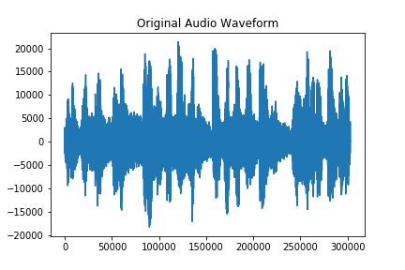
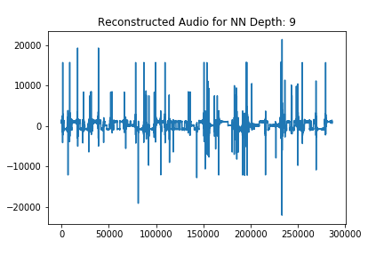

Waveforms & Audio : Training

Slide 25
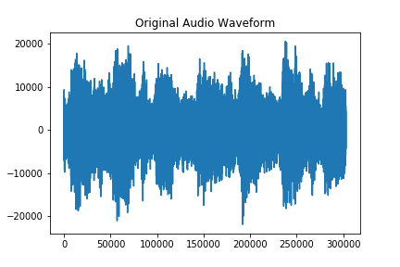
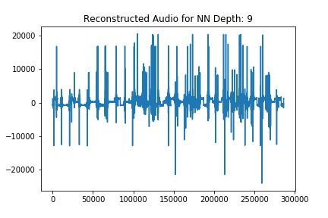
Waveforms & Audio : Testing

Slide 26
Waveforms & Audio :
Testing on 90% of songs

Slide 27
5.
Conclusions and Future

Slide 28
Summary and Takeaways
Preprocessing
Cleaning of data, channel selection, and preprocessing
Time Series Manipulation
Feature selection, moving time windows and downsampling.
Neural Networks
Sequential batch learning and audio reconstruction

Slide 29
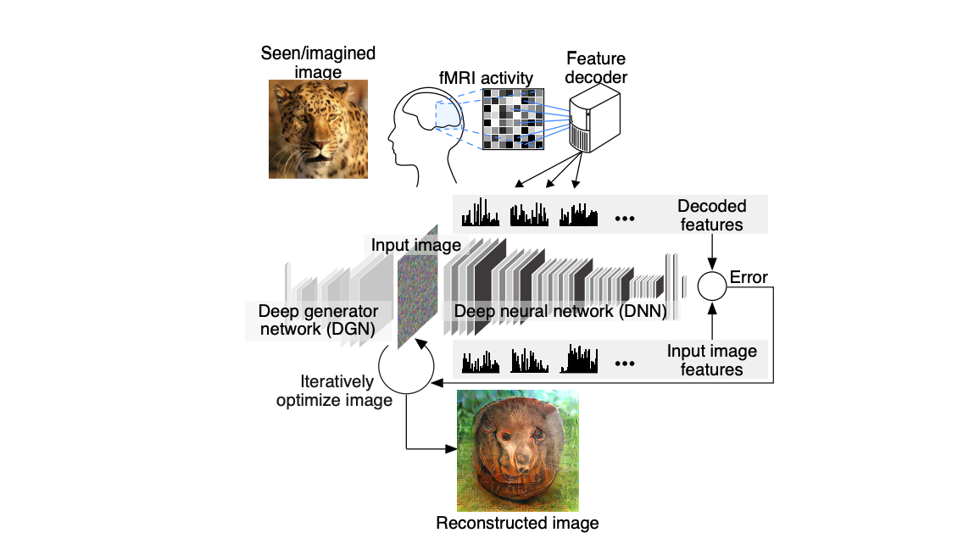
Future Directions
The Field
Our Investigation
Variational Autoencoders
GANs
Music style translation
Network Architecture
CNN
RNN/ LSTM
More EEG Data
Less downsampling

Slide 30
References
Yao, Y., Plested, J. & Gedeon, T. Deep Feature Learning and Visualization for EEG Recording Using Autoencoders. in Neural Information Processing 554–566 (Springer International Publishing, 2018).
Potes, C., Gunduz, A., Brunner, P. & Schalk, G. Dynamics of electrocorticographic (ECoG) activity in human temporal and frontal cortical areas during music listening. Neuroimage 61, 841–848 (2012).
Sturm, I., Blankertz, B., Potes, C., Schalk, G. & Curio, G. ECoG high gamma activity reveals distinct cortical representations of lyrics passages, harmonic and timbre-related changes in a rock song. Front. Hum. Neurosci. 8, 798 (2014).
Paul, Y. Various epileptic seizure detection techniques using biomedical signals: a review. Brain Inform 5, 6 (2018).
Nemrodov, D., Niemeier, M., Patel, A. & Nestor, A. The Neural Dynamics of Facial Identity Processing: Insights from EEG-Based Pattern Analysis and Image Reconstruction. eNeuro 5, (2018).
Elgohary, S., Eldawlatly, S. & Khalil, M. I. Epileptic seizure prediction using zero-crossings analysis of EEG wavelet detail coefficients. in 2016 IEEE Conference on Computational Intelligence in Bioinformatics and Computational Biology (CIBCB) 1–6 (2016).
Esteller, R., Echauz, J., Tcheng, T., Litt, B. & Pless, B. Line length: an efficient feature for seizure onset detection. in 2001 Conference Proceedings of the 23rd Annual International Conference of the IEEE Engineering in Medicine and Biology Society 2, 1707–1710 vol.2 (2001).

Slide 31
QUESTIONS?

